Slide 1
Character webs

Slide 2
What information should go in a Twelfth Night character web?
Names of characters
Characteristics of characters (personalities, likes or dislikes, etc)
How the characters relate to one another
One quote for each character (from Shakespeare’s play) that represents him/her well

Slide 3
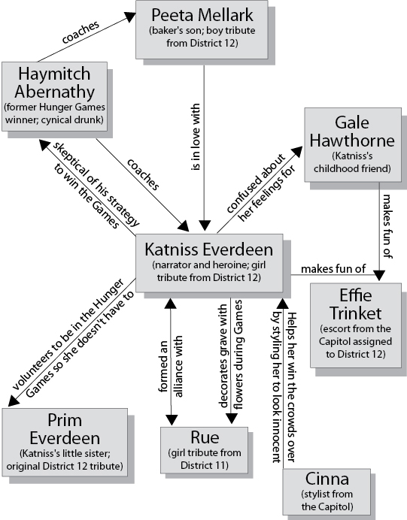

Slide 4
Your task:
You will create a character web for all the major characters in the play. You must cover all of the requirements as listed on the pervious slide. Ensure that you’ve properly connected all major characters. You can do so on the computer or by hand – ensure that your character web looks polished and is complete. Use the Hunger Games example as a model.

